Slide 1
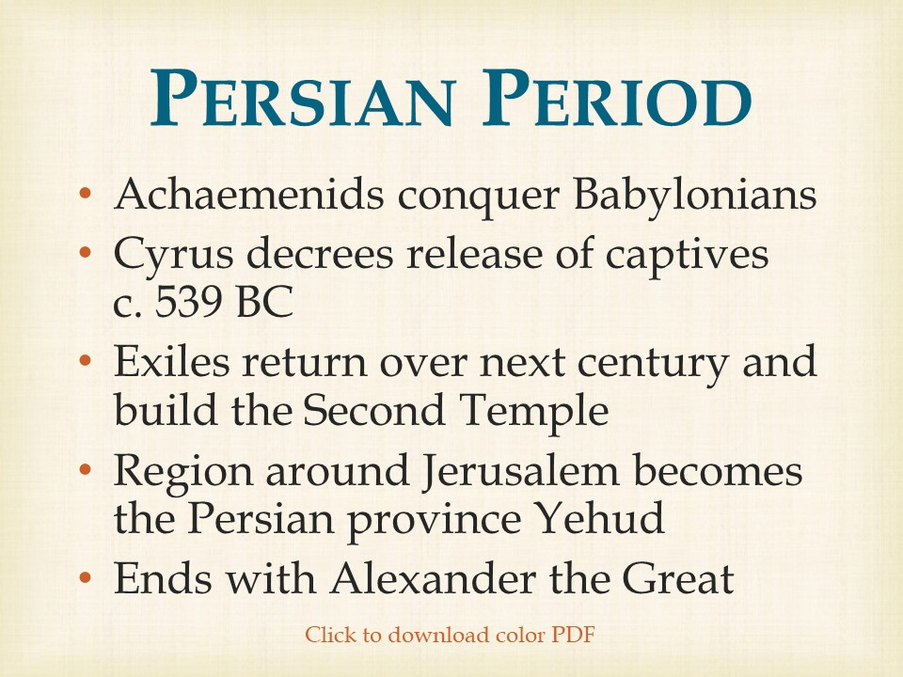

Slide 2
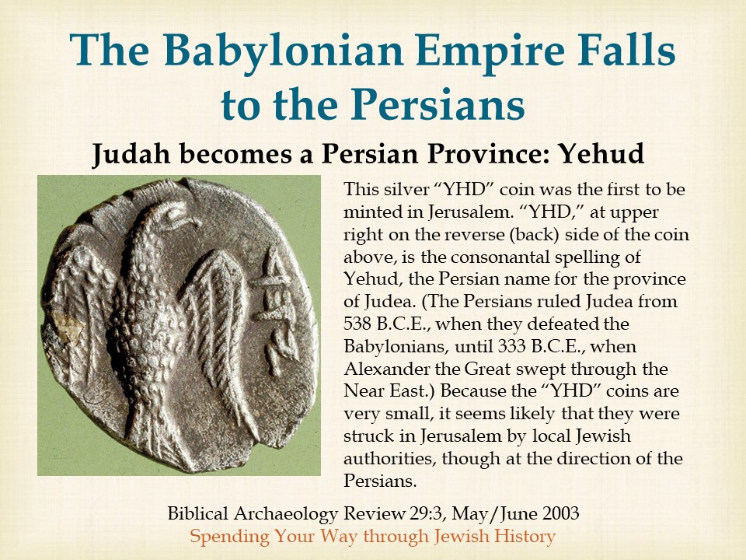

Slide 3
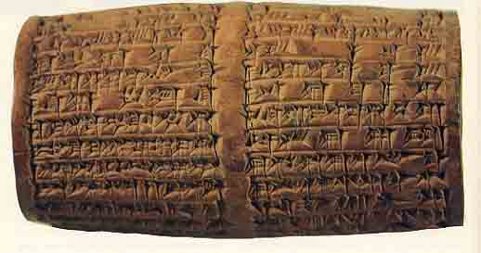
Nabonidus Cylinder
555 BC – 540 BC
Belshazzar and his father Nabonidus are named on this clay cylinder found at Babylon. King Cyrus of Persia, who conquered Babylon in 539 B.C., describes a morally bankrupt Belshazzar.
The cuneiform characters on the nearly four-inch-long cylinder record Cyrus’s defeat of Nabonidus and his capture of Babylon. Cyrus restored the pagan gods to their sanctuaries and returned captive peoples, including the Israelites, to their homelands, all at his own expense. “I returned to these sacred cities on the other side of the Tigris, the sanctuaries of which have been ruins for a long time, the images which used to live therein and established for them permanent sanctuaries. I also gathered all their former inhabitants and returned to them their habitations.”
Biblical Archaeology Review 11:3, May/June 1985
Daniel and Belshazzar in History
Notes:
‹#›

Slide 4
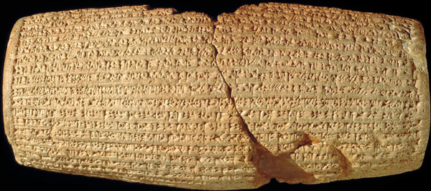
King Cyrus of Persia
Allows Exiled Jews to Return and Rebuilds the Temple
Cyrus Cylinder
The cuneiform inscription on this 10-inch-long clay barrel tells of Cyrus the Great’s liberation of Babylon in 539 B.C.E., his benevolence to peoples previously subjugated under the Babylonians and his restoration of local religious practices.
The inscription reads in part: “I returned to (these) sacred cult-cities on the other side of the Tigris, the sanctuaries of which have been ruins for a long time, the gods who live in them and established for them eternal sanctuaries. I (also) gathered all their inhabitants and returned them to their habitations.” It thus supports the account of Cyrus’s restoration of the Jerusalem Temple recorded in the biblical books of Ezra and Isaiah.
Bible Review 19:5, October 2003
Cyrus the Messiah
Notes:
‹#›

Slide 5
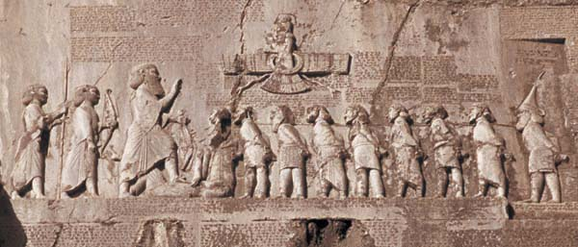
Darius I, “The Great”
High up on a cliff face in Bisitun, in western Kurdistan, Darius had his claim as rightful successor to Cyrus the Great carved into stone. The tall figure of Darius stands at left, with his foot on the supine Gaumata “the Magus,” pretender to the throne, before nine rebel kings who are bound at the neck.
Archaeology Odyssey 8:6, November/December 2005
Making (Up) History

Slide 6
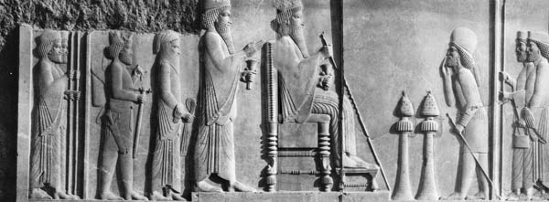
Xerxes 486-465 BC
Crown prince Xerxes, the future ruler of Persia and known in the Book of Esther as King Ahasuerus, stands behind his father Darius I (ruled 521–486 B.C.E.) in a stone relief from the main banquet hall at the royal palace at Persepolis. Xerxes’ impetuous yet fateful decision to ban his wife Vashti and to replace her with a new queen (according to the account in Esther) put in motion a series of events that staved off a dire threat to the survival of the Jews in the Persian empire.
Bible Review 8:1, February 1992
The Book of Esther

Slide 7
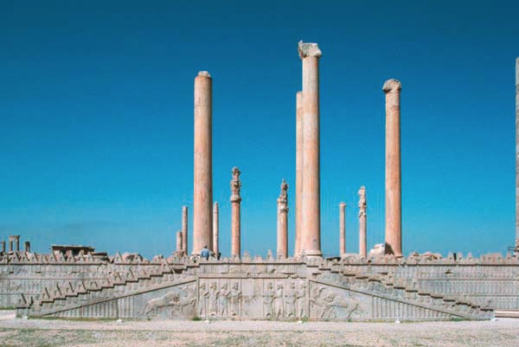
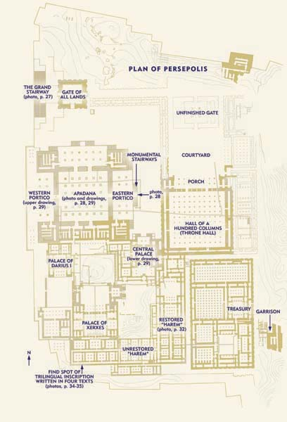
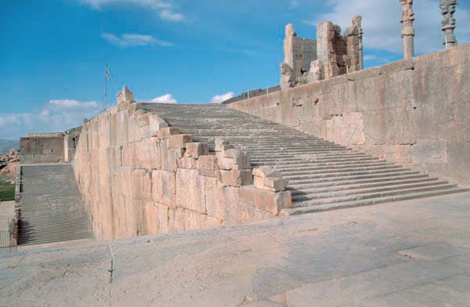
Palace of Xerxes
(Ahasuerus) at Persepolis
Delegations from all over the Persian empire were probably received by the king in Persepolis’s Apadana, a vast reception hall. The Apadana had elaborate porticoes on the north, east and west sides , as well as monumental stairways with relief carvings on the north side and east side. The main chamber of the Apadana was a huge square, 200 feet on a side, with six rows of six columns topped by bull’s-head capitals. To the southeast of the Apadana was the Central Palace (also called the Council Hall)
Archaeology Odyssey 8:6, November/December 2005
Why Darius Built Persepolis

Slide 8
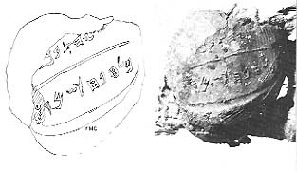
Sanballat and Nehemiah
Nehemiah’s Sanballat is also mentioned in a papyrus from Elephantine in upper Egypt. He is well known as the devious and malicious enemy of Nehemiah. He was governor of the province of Samaria in 445 B.C., when Nehemiah arrived in Zion.
Sanballat gained notoriety in the Bible for his opposition to the restoration of the walls of Jerusalem, and for conspiring against the life of Nehemiah, in league with Tobiah, the Jewish governor of Amman, and Gashmu (Geshem), king of the Qedarite league.
Nehemiah, prevailed and fortified Jerusalem, increased its population, and completed his first tour of duty as governor in 433 B.C.
A seal attached to a worm-eaten papyrus scrap bearing the name (in paleo-Hebrew script) of the Governor of Samaria, a son of Sanballat II.
Biblical Archaeology Review 4:1, March 1978
The Historical Importance of the Samaria Papyri
Notes:
‹#›

Slide 9
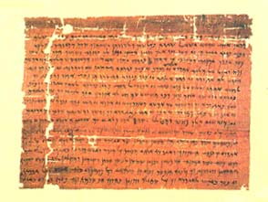
Elephantine Temple Papyrus
407 BC
“Moreover, all the(se) words in one (=a single) letter we sent in our name to Delaiah and Shelemiah sons of Sanballat governor of Samaria.”
Biblical Archaeology Review 21:3, May/June 1995
Did the Ark Stop at Elephantine?

Slide 10
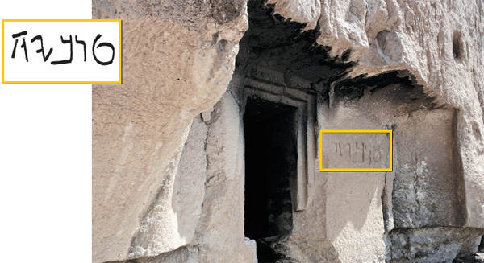
Cave of the Tobiads
Piercing the limestone cliffs north of Qasr al-Abd are caves that, according to Josephus, were used by Hyrcanus for entertaining, as well as security. Two of the caves were carved with recessed doorways, beside which the family’s name (TOBYH) was written in late paleo-Hebrew script. Rosenberg believes the caves may have also been used to inter the family’s dead before the bones were finally deposited in sarcophagi resting inside the mausoleum.
Biblical Archaeology Review 38:3, May/June 2012
“Castle of the Slave”—Mystery Solved

Slide 11
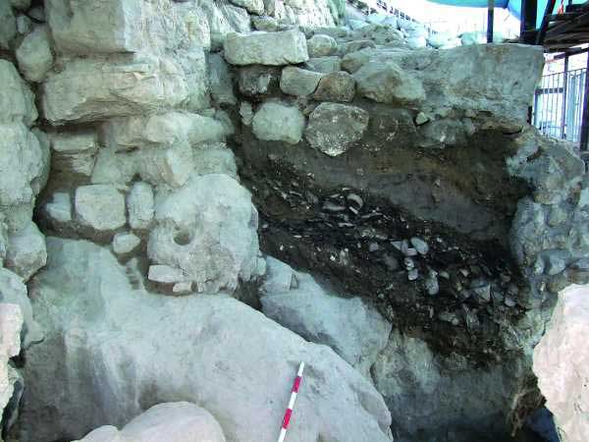
Nehemiah’s Wall
5th BC
Once the Northern Tower had been dismantled for restoration, Mazar and her team were able to excavate beneath it. There they found strata rich with pottery and two dog burials—a practice that dates to the Persian period in Israel (538–332 B.C.E.). They did not find any jar handles stamped with the Persian provincial name “Yehud,” however, which became common in the second half of the fifth century.
Based on the styles of the pottery assemblage, the dog burials and the lack of “Yehud” stamps, Mazar dates the construction of the tower to the mid-fifth century B.C.E.—right around the time the Bible says that Nehemiah rebuilt the walls of Jerusalem, in 445 B.C.E.
Biblical Archaeology Review 35:2, March/April 2009
The Wall That Nehemiah Built

Slide 12
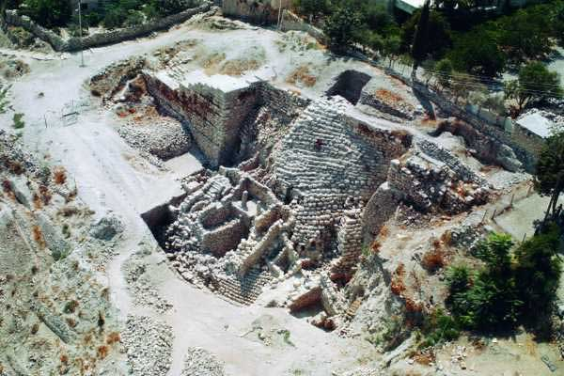
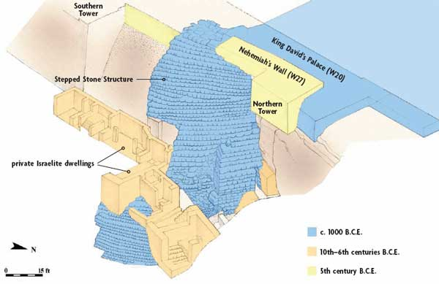
Nehemiah Rebuilds the Walls of Jerusalem
The City of David is the most ancient part of Jerusalem. It has been built and rebuilt countless times through the ages. This reconstruction drawing shows the close relationship of the different structures at the top of the eastern slope: the Stepped Stone Structure supported King David’s palace; Wall 20 of the palace actually joins the Stepped Stone Structure. The Northern Tower and adjoining Wall 27 (Nehemiah’s wall) were built on top of this complex by the returning exiles after it had been destroyed by the Babylonians.
Biblical Archaeology Review 35:2, March/April 2009
The Wall That Nehemiah Built
Notes:
‹#›

Slide 13
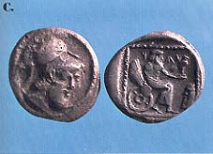
Silver Coin From Judea “Yehud”
Biblical Archaeology Review 4:1, March 1978
The Holy Land in Coins
A silver drachma struck in Judaea during the period in the 4th century B.C. when Persia controlled Palestine. The coin bears the Aramaic inscription Yehud, the name of the Persian satrapy of Judaea. The design imitates an Athenian coin. It shows a god seated on a winged chariot and holding in his left hand a falcon.

